Slide 1
Zoom training for annual meeting of the convention
Desktop/lap top views have a solid red background
Tablet views have a blue background
Smart phone views have a gold background

Slide 2
Housekeeping
Please mute your microphone, stop your video, and be in speaker view. If you do not know how to do this, don’t worry, we will cover this is in later slides.
This meeting is being recorded and a link to the recording will be on the diocese’s 52nd convention webpage.
We will answer as many questions as possible in the time allotted
Hopefully, you were able to download the zoom app to your device

Slide 3
Zoom And
Be mindful of your background setting.
Close doors behind you,
Dress appropriately top and bottom
Alert your family that you have the camera “live,”
Silence all the noisemakers in your space and
Sit with light in front of you, not behind you.
Turn off your microphone
Turn off your video
Be in speaker mode
Use headset/pods that can plug in
Avoid munching and background noises
Large movements
Having the camera below you
Having the camera too high
Use an iPhone unless not possible

Slide 4
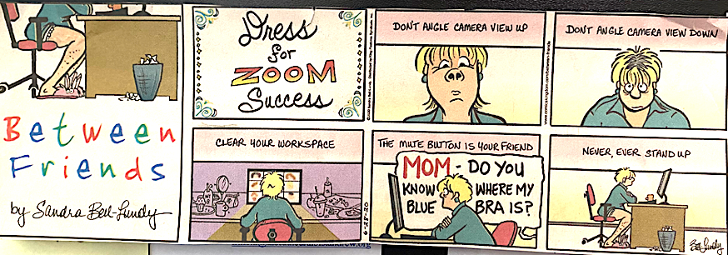

Slide 5
Timetable for the annual meeting
8:30 am – 9:45 am: credentials (check-in)
10:00 am – 11:00 am: session #1
11:00 am – 11:15 am: break
11:15 am – 12:15 pm: session #2
12:15 pm – 1:00 pm: Lunch break
1:00 pm – 2:00 pm: session #3

Slide 6
Zoom – logging into the meeting
Click on the link provided in your confirmation email

Slide 8
MAC laptop view

Slide 9
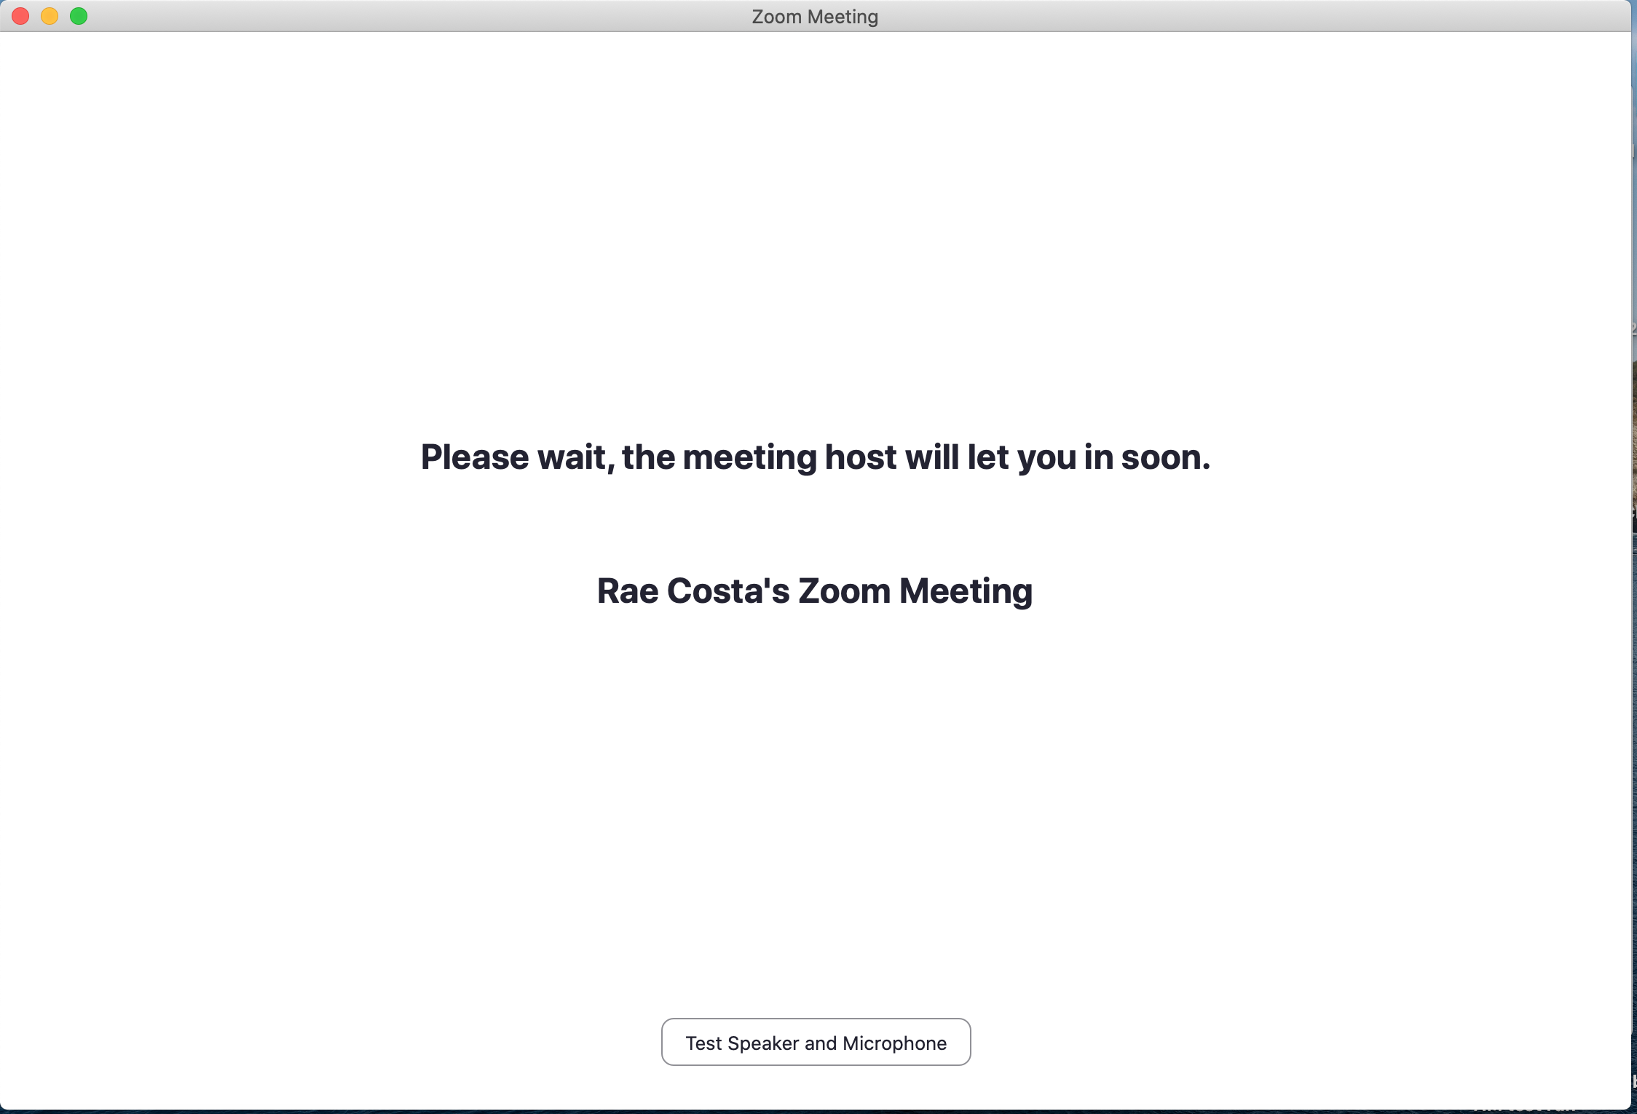
Macbook view

Slide 10
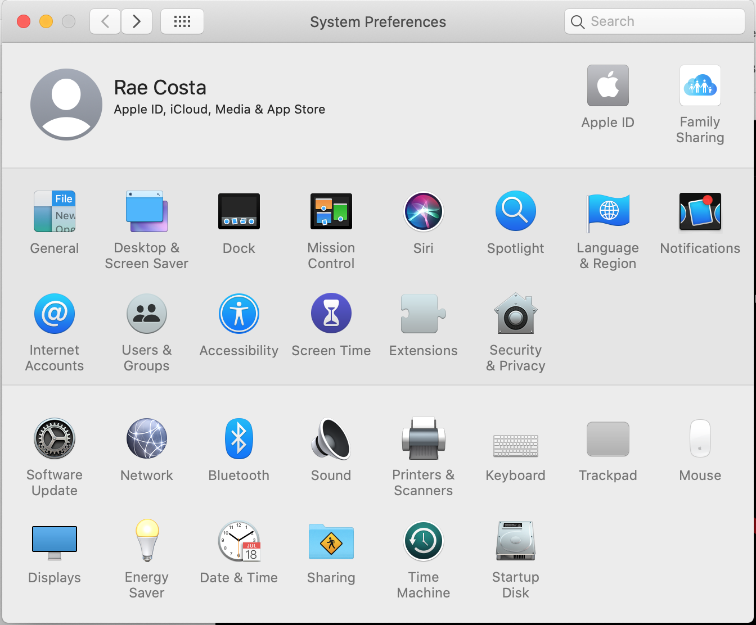
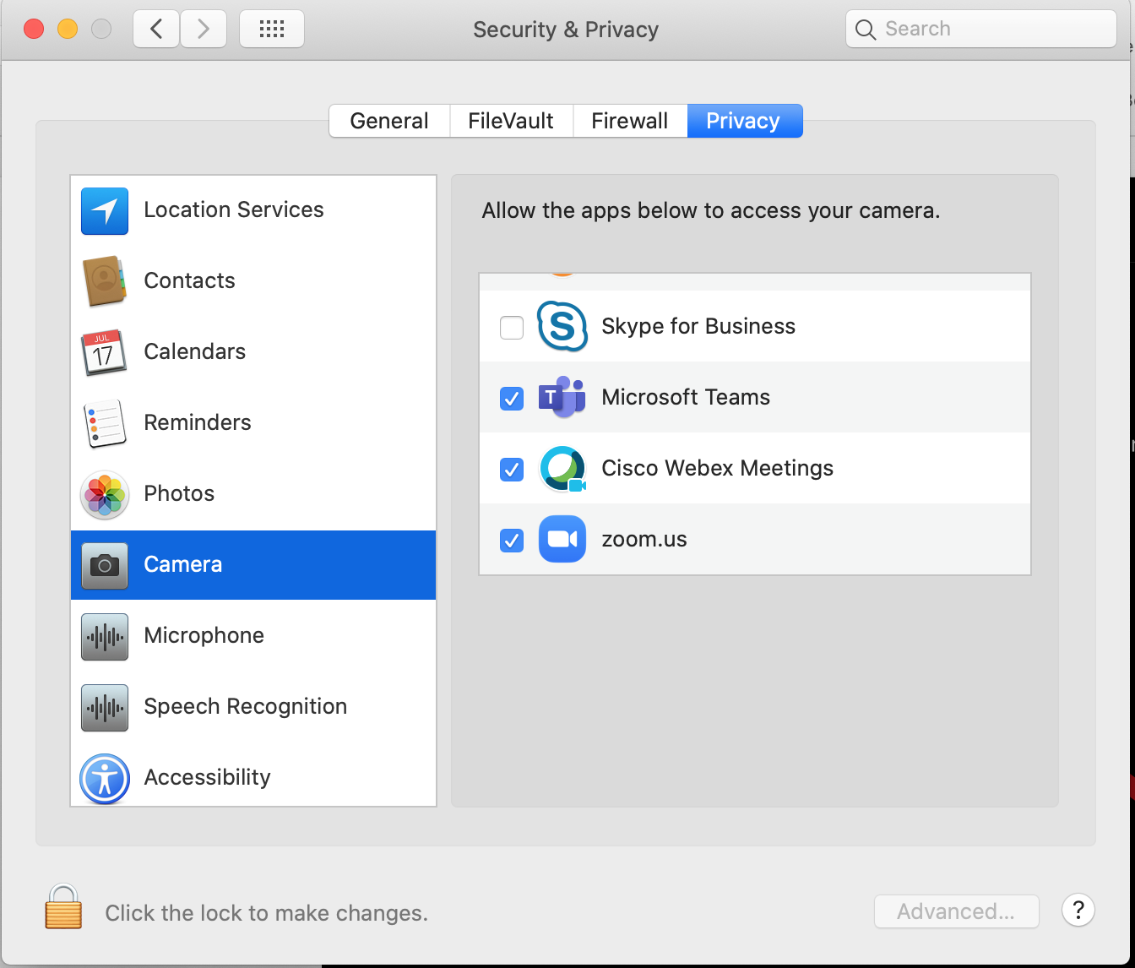
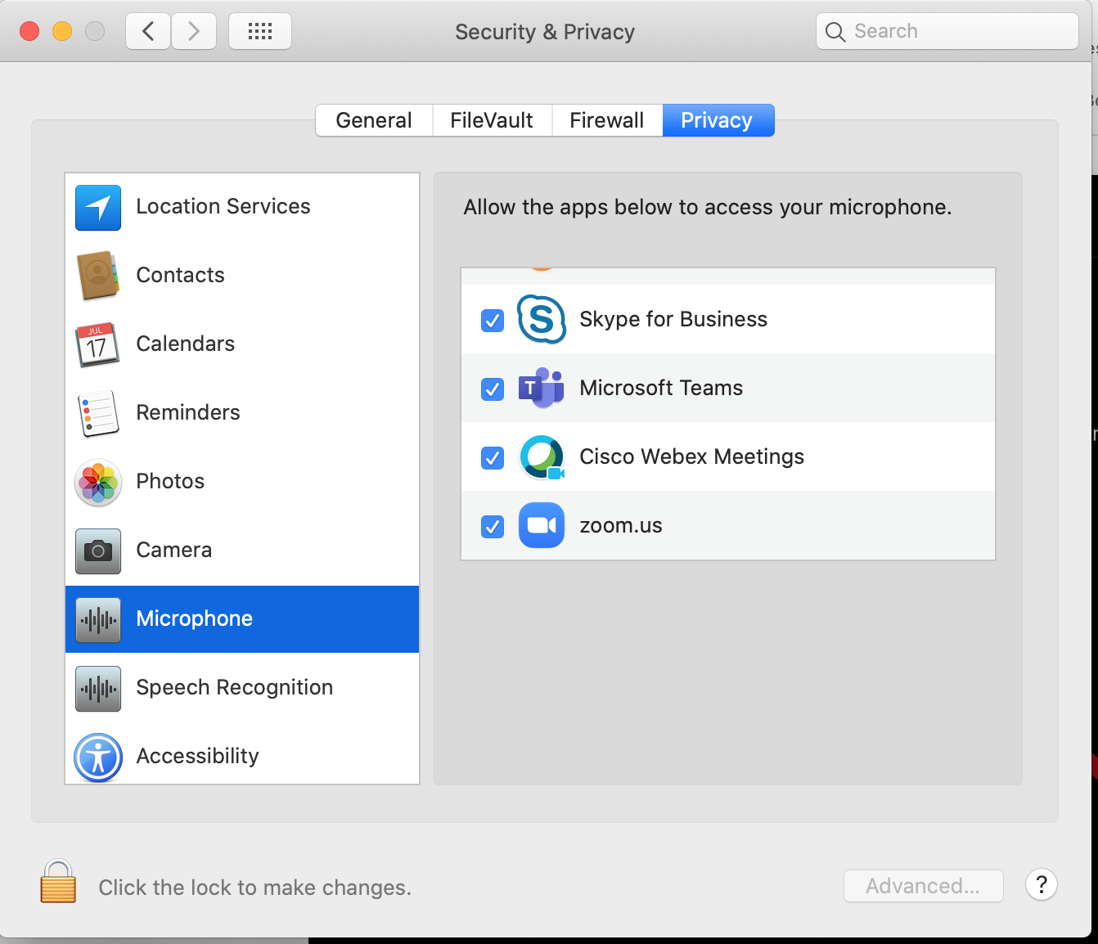
In case you are prompted by Macbook to update privacy settings
3. Click on Privacy tab
3
4. Click on Camera
2
5. Check box next to Zoom
4
5
1. Open System Preferences
2. Click on Security & Privacy
6. Repeat the process for Microphone
6

Slide 11
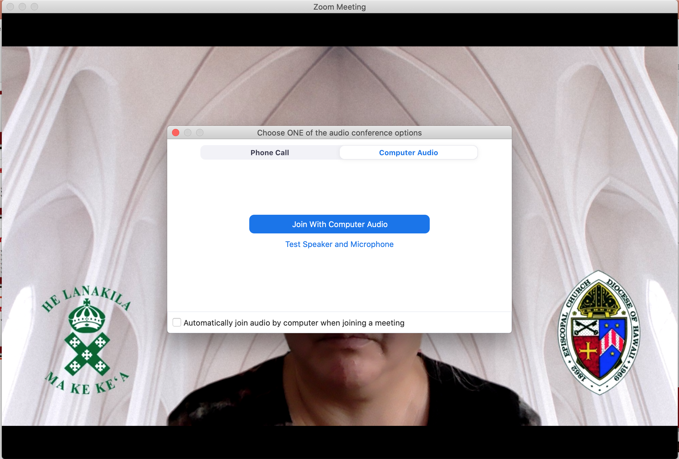
Macbook Pro view

Slide 12
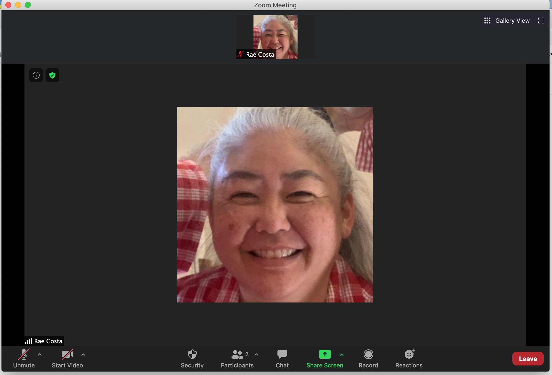
Macbook pro view
Microphone muted
Video stopped

Slide 13
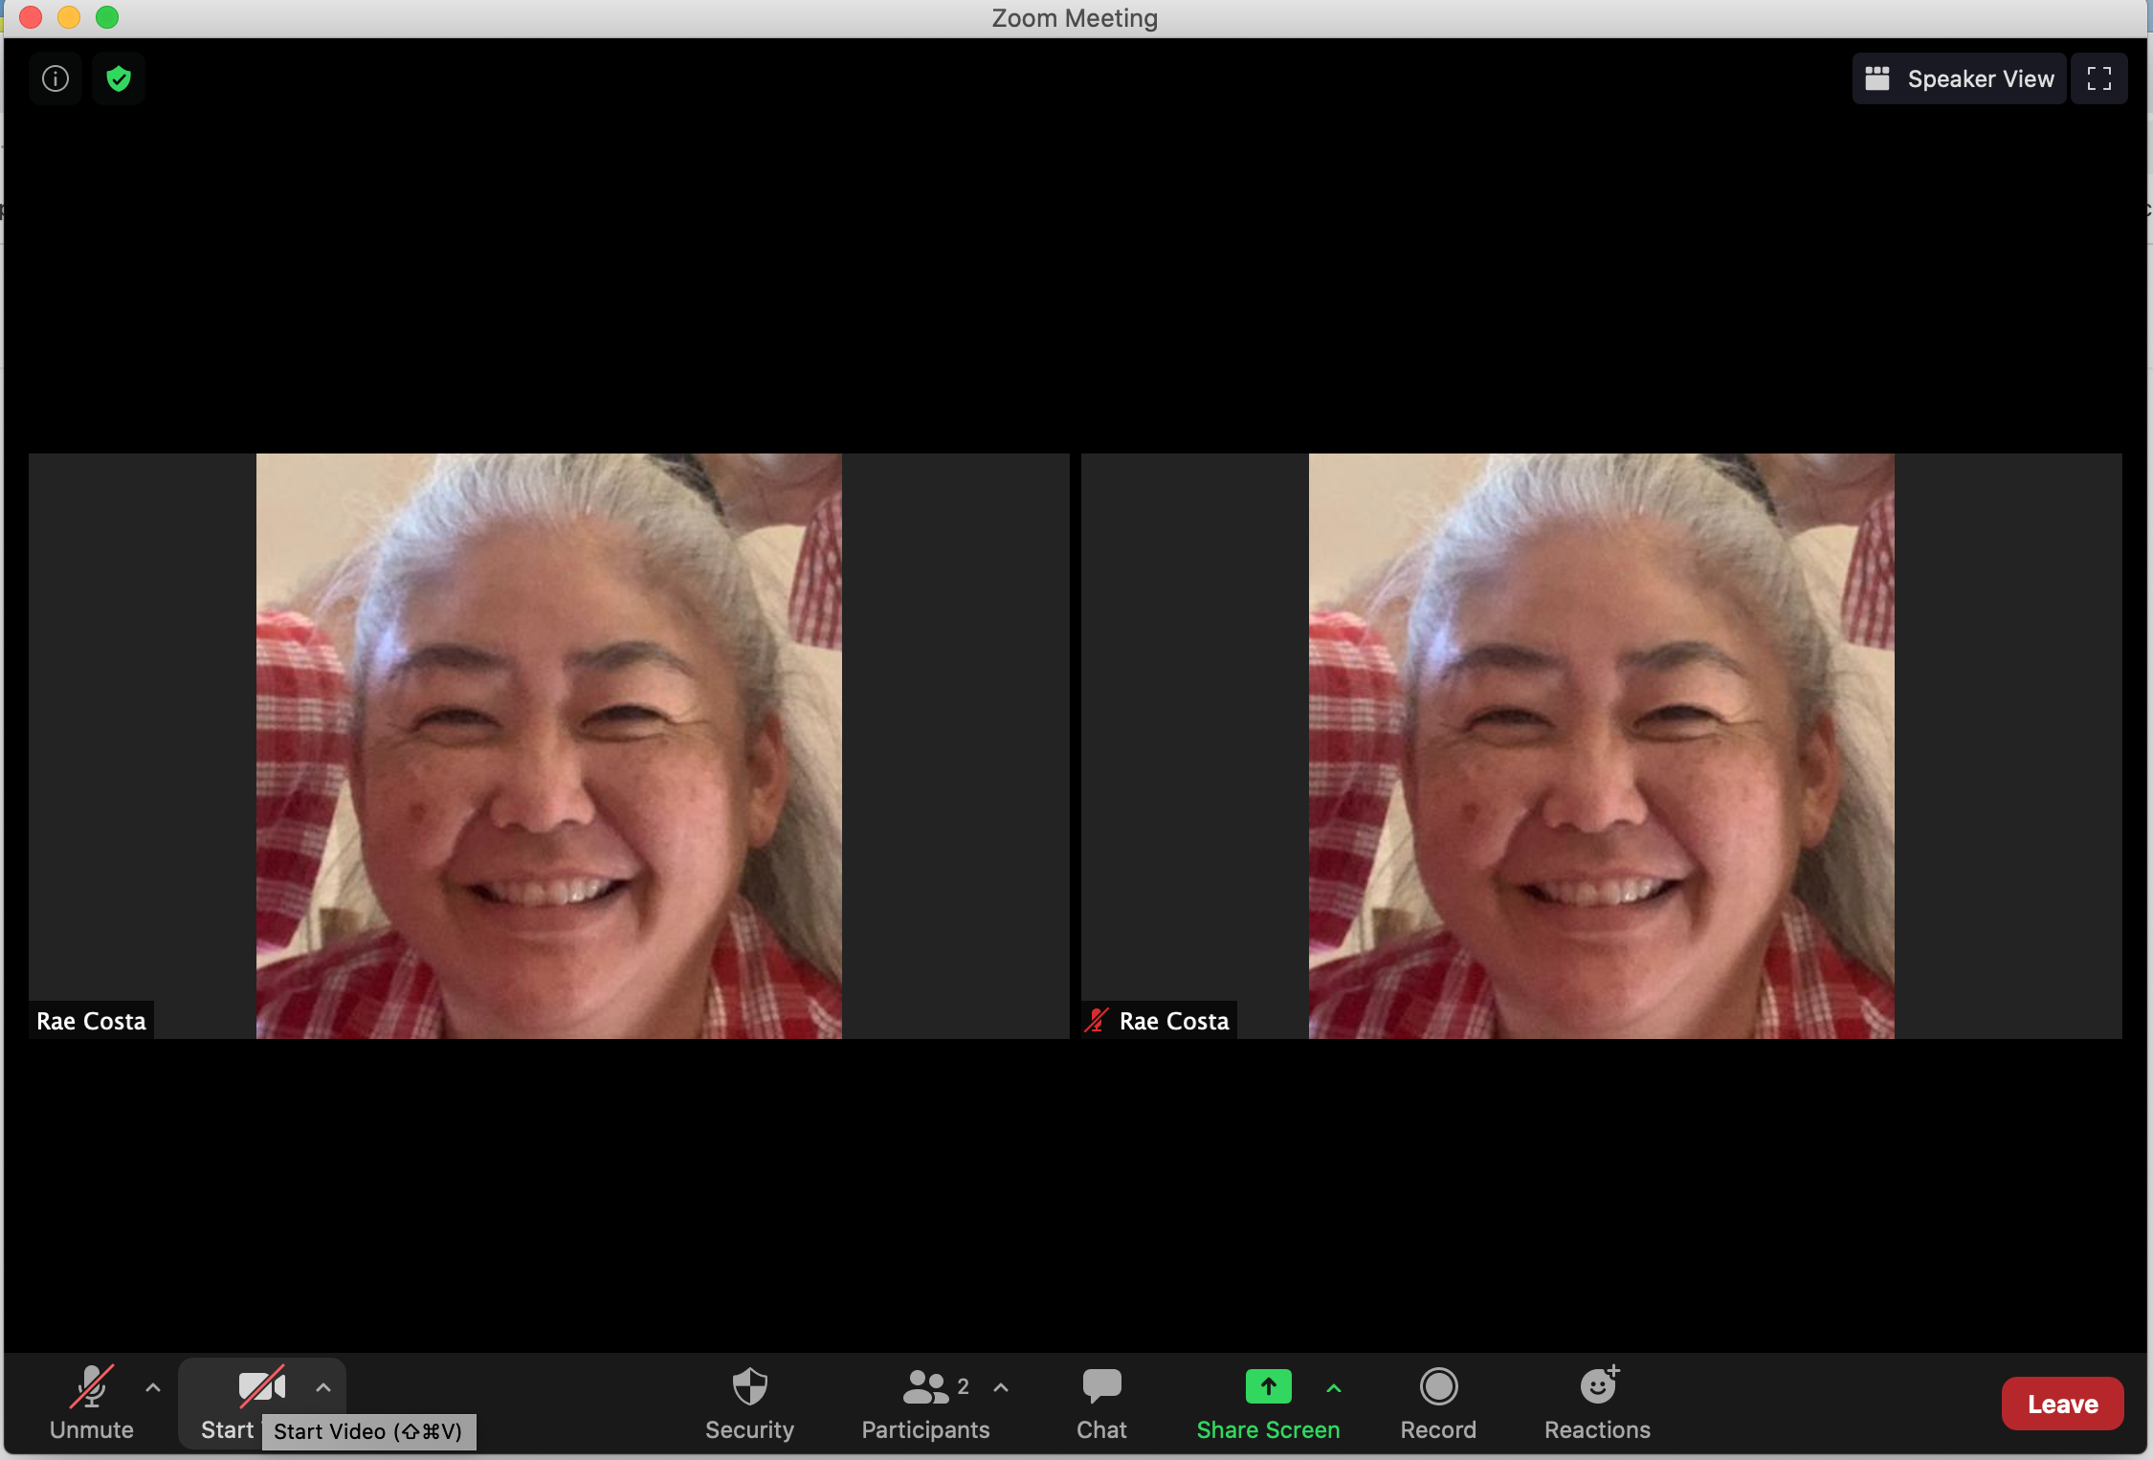
Macbook pro GALLERY view

Slide 14
Macbook SPEAKER view

Slide 15
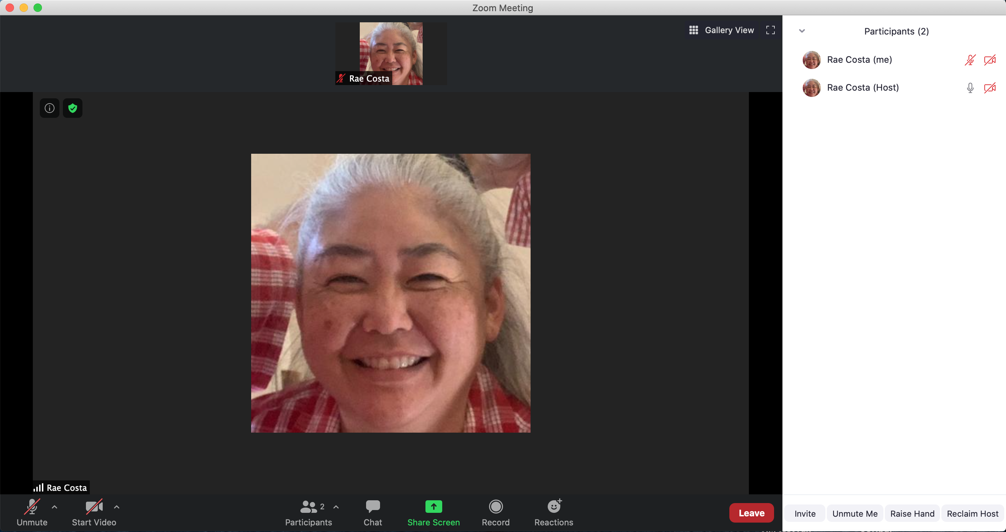
How to raise your VIRTUAL hand
Macbook view
1. Click on Participants
2. Click on Raise Hand
1
2

Slide 16
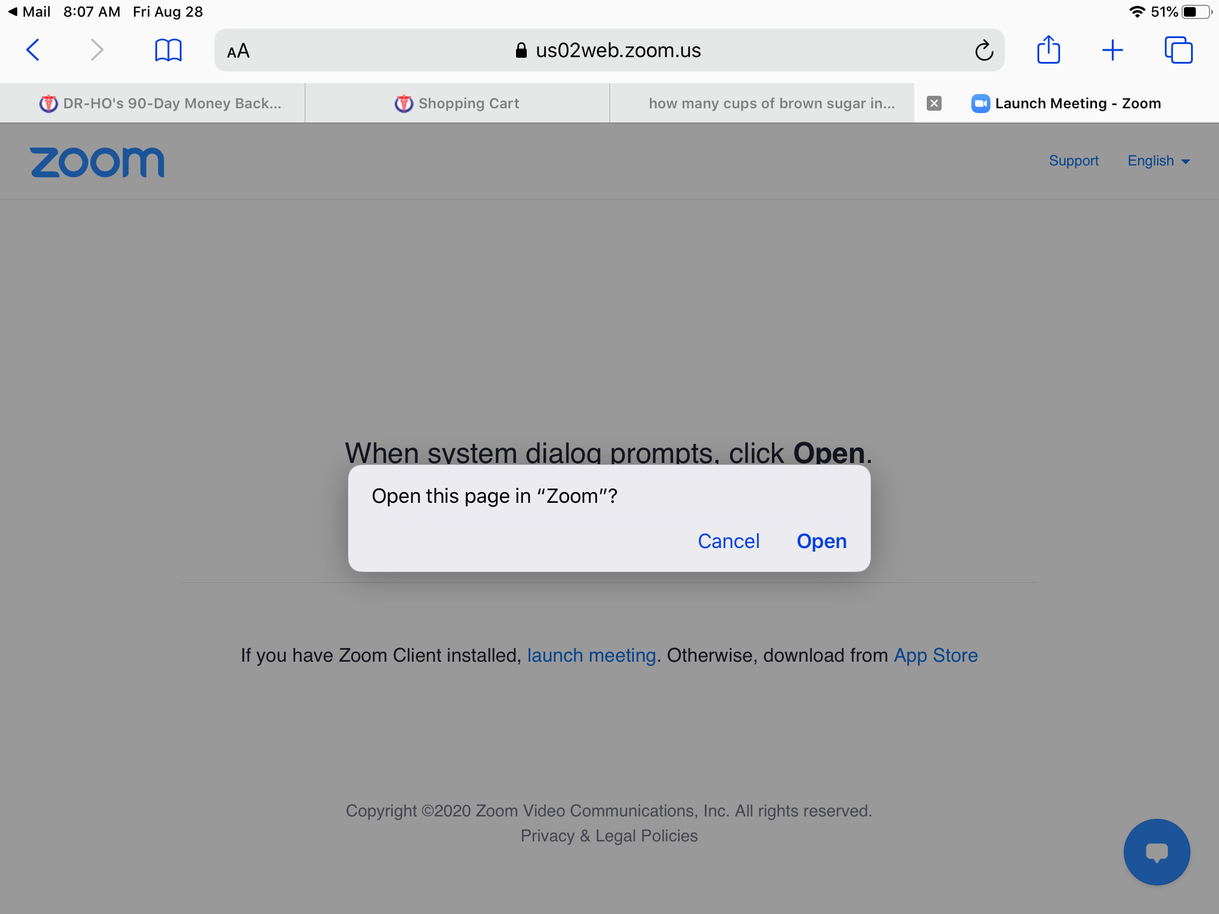
Tablet (iPad) view

Slide 17
Tablet (iPad) view

Slide 18
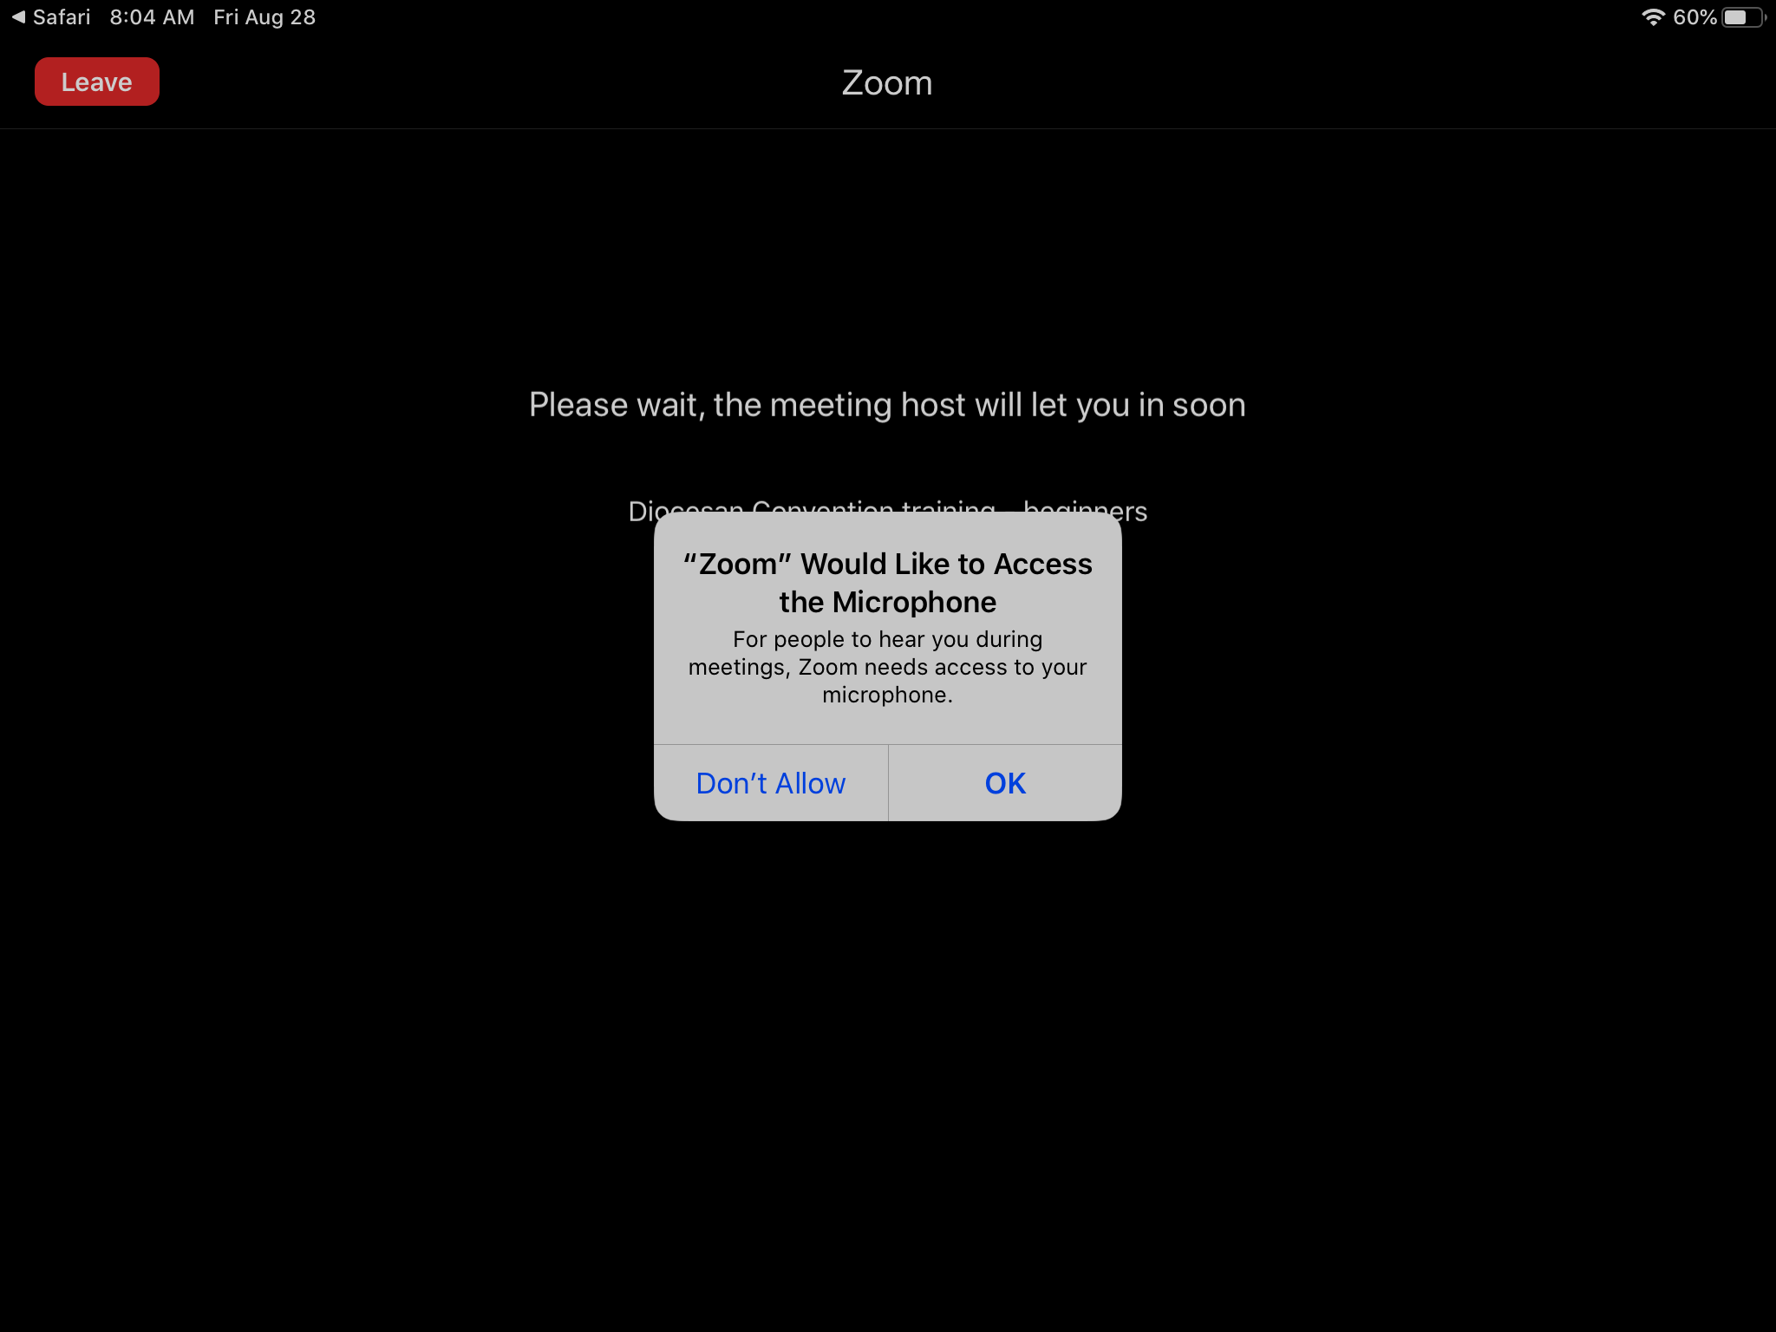
Tablet (iPad) view

Slide 19
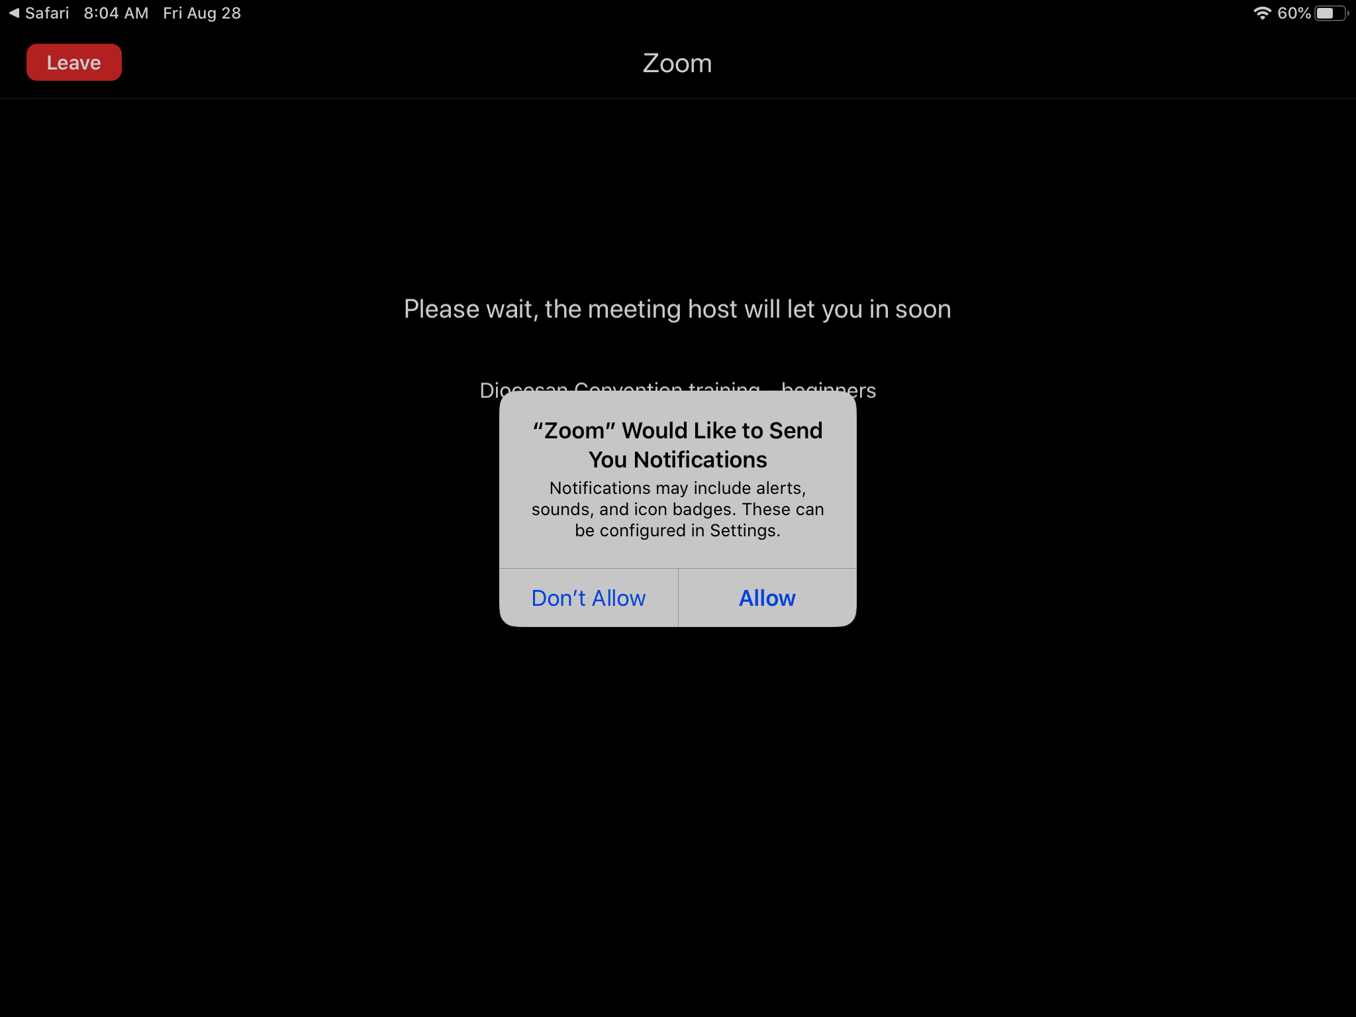
Tablet (iPad) view

Slide 20
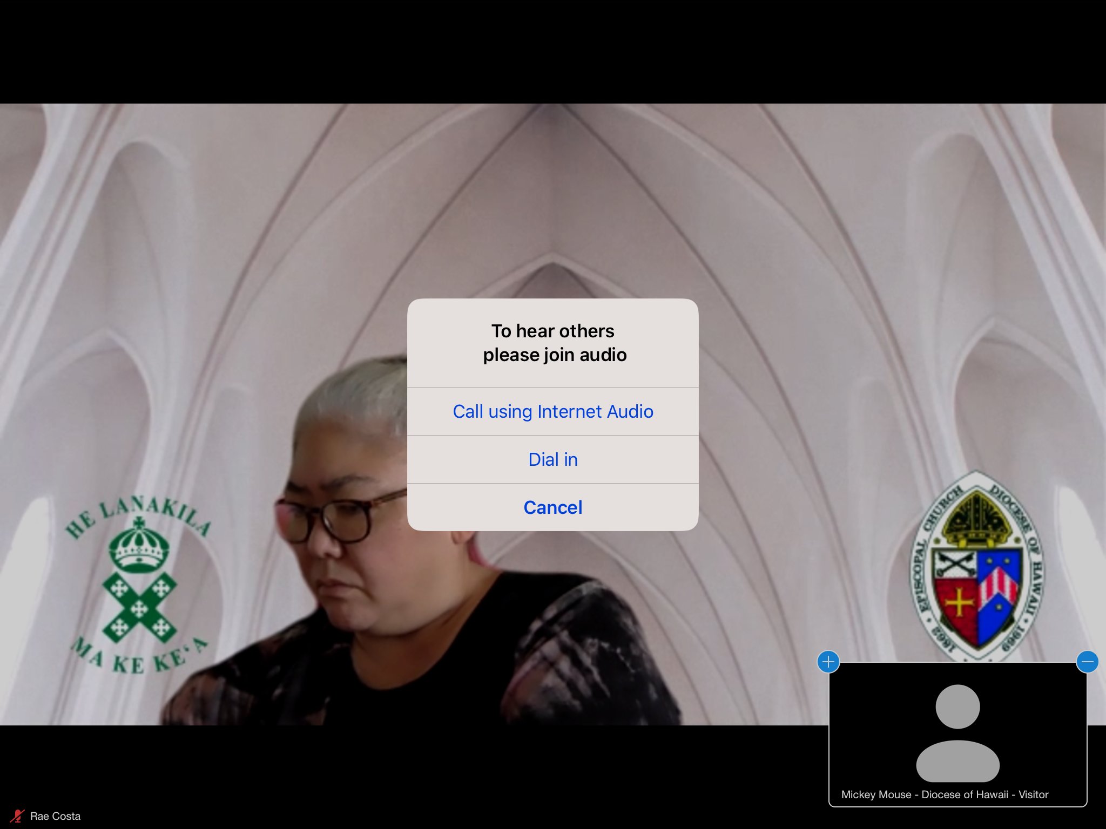
Tablet (iPad) view

Slide 21
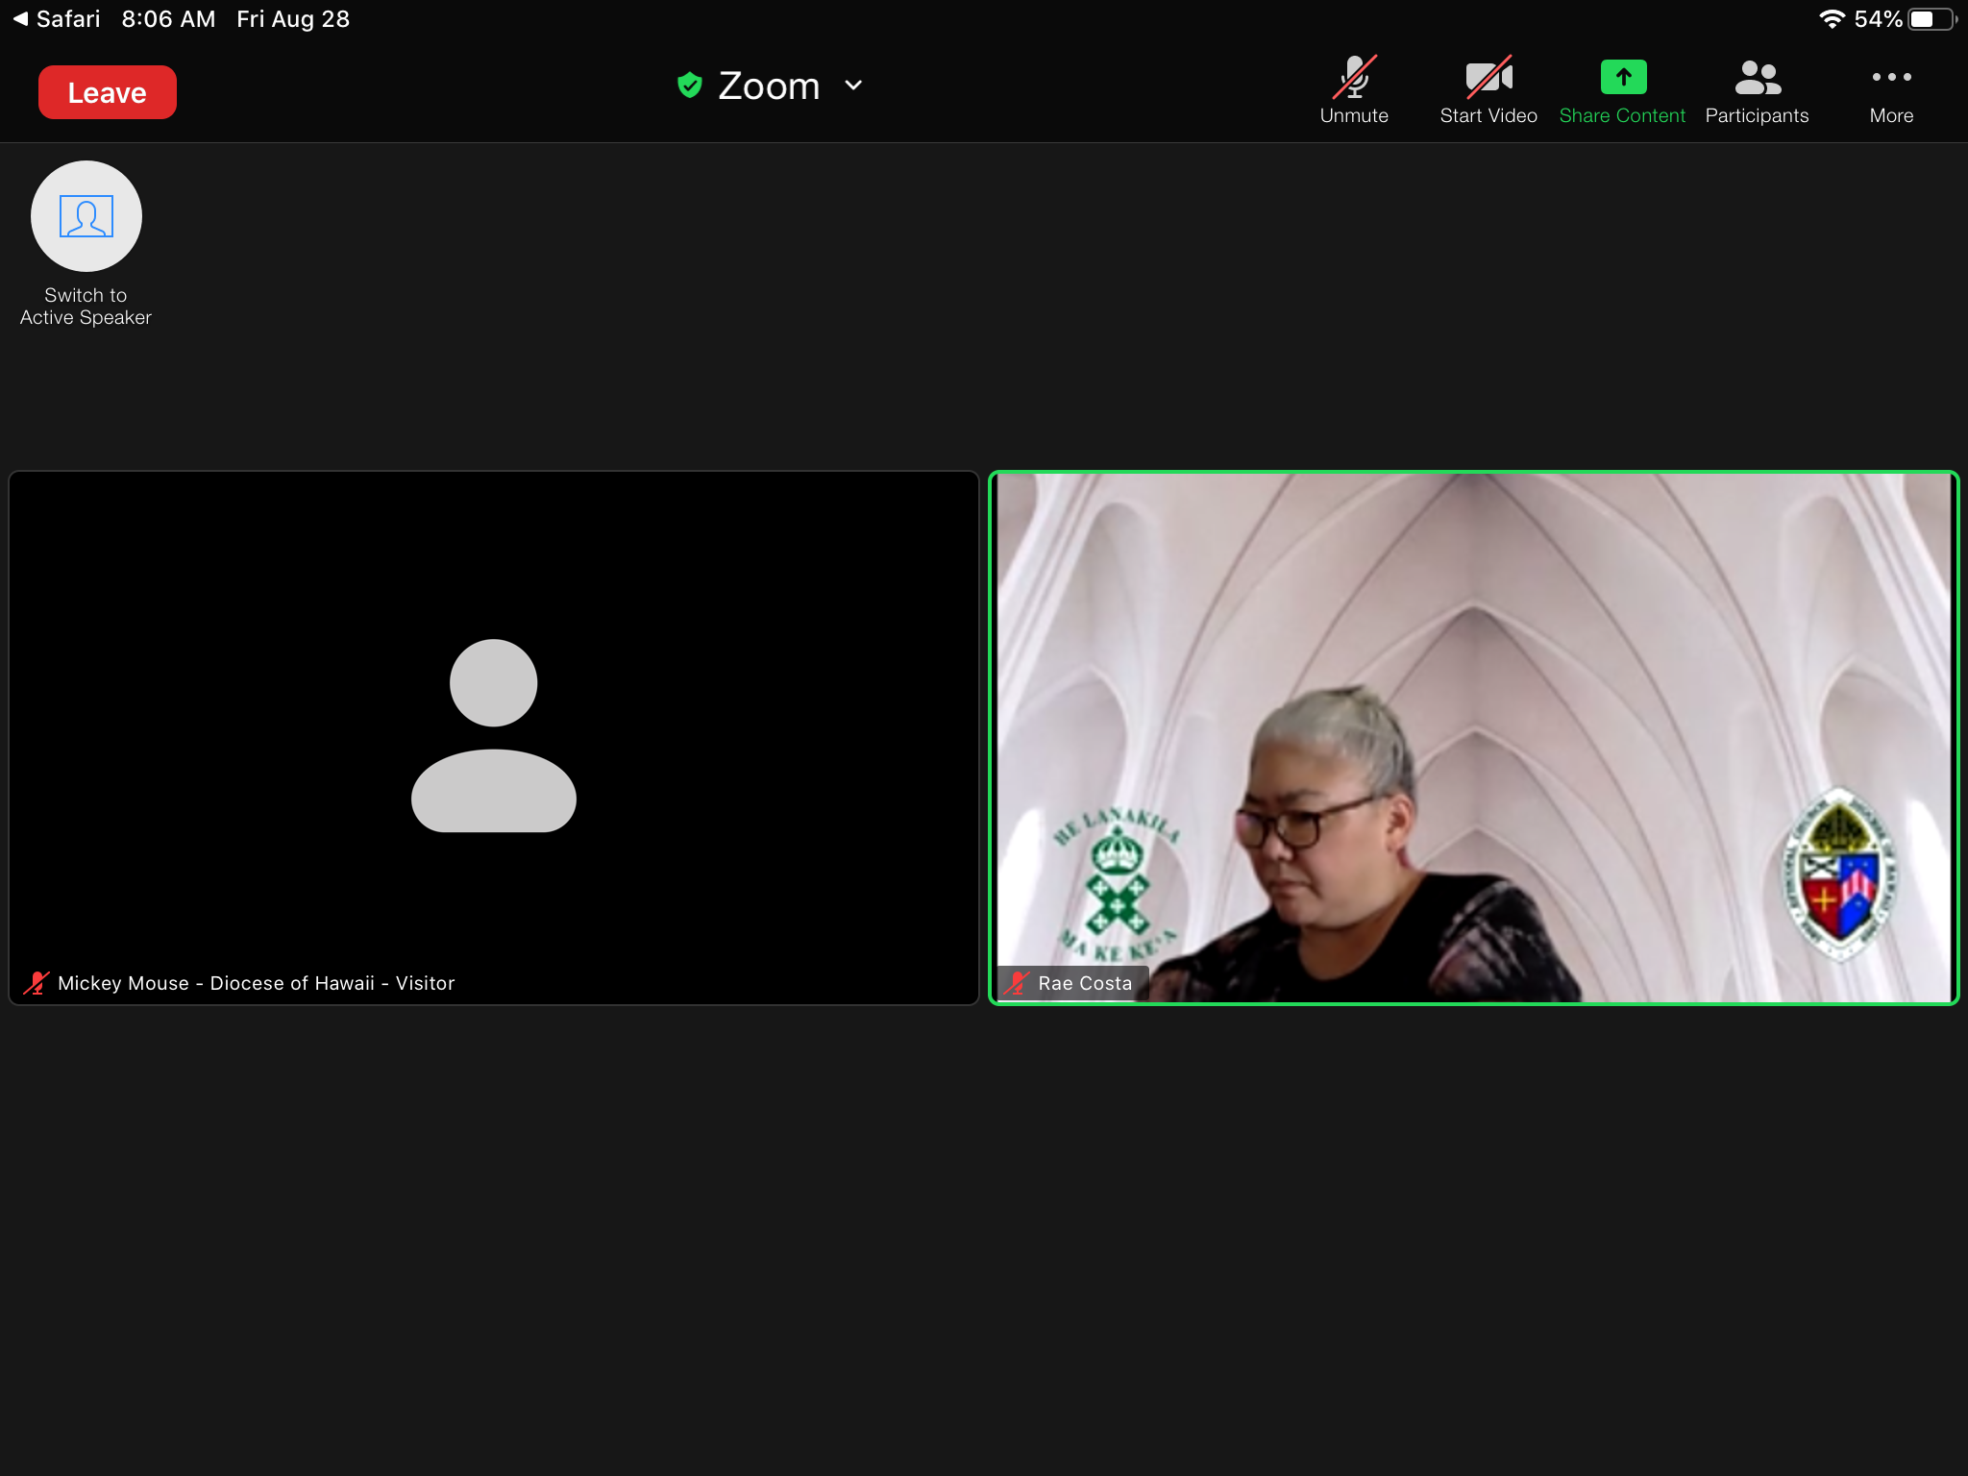
Tablet (iPad) view
Microphone muted
Video stopped

Slide 22
Tablet (iPad) GALLERY view

Slide 23
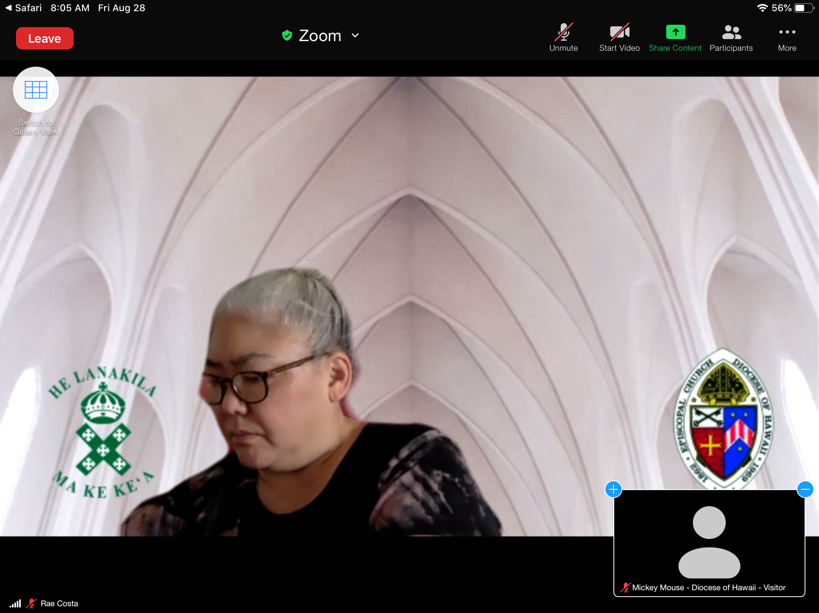
Tablet (iPad) SPEAKER view

Slide 24
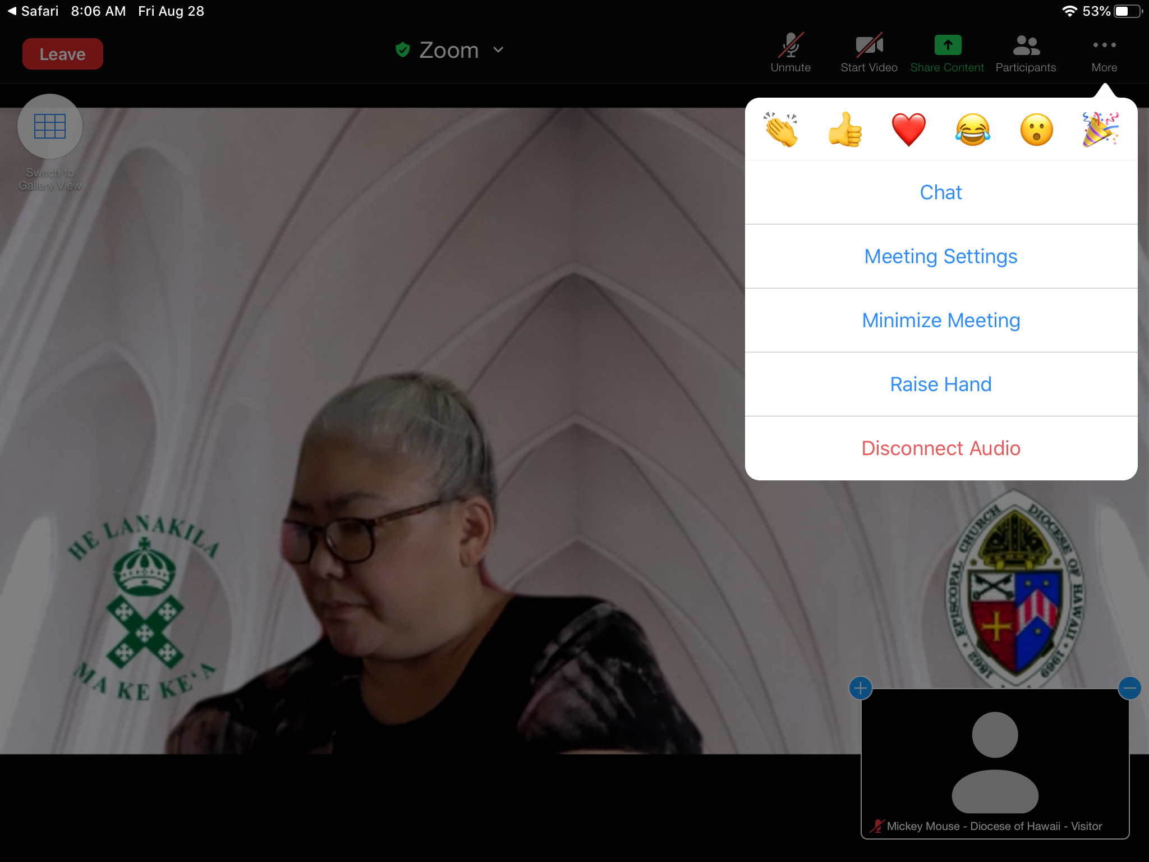
How to raise your VIRTUAL hand
1
1. Tap on More
2. Tap Raise Hand
Note: we will not be using the emojis at the top
2
Tablet (iPad) view

Slide 25
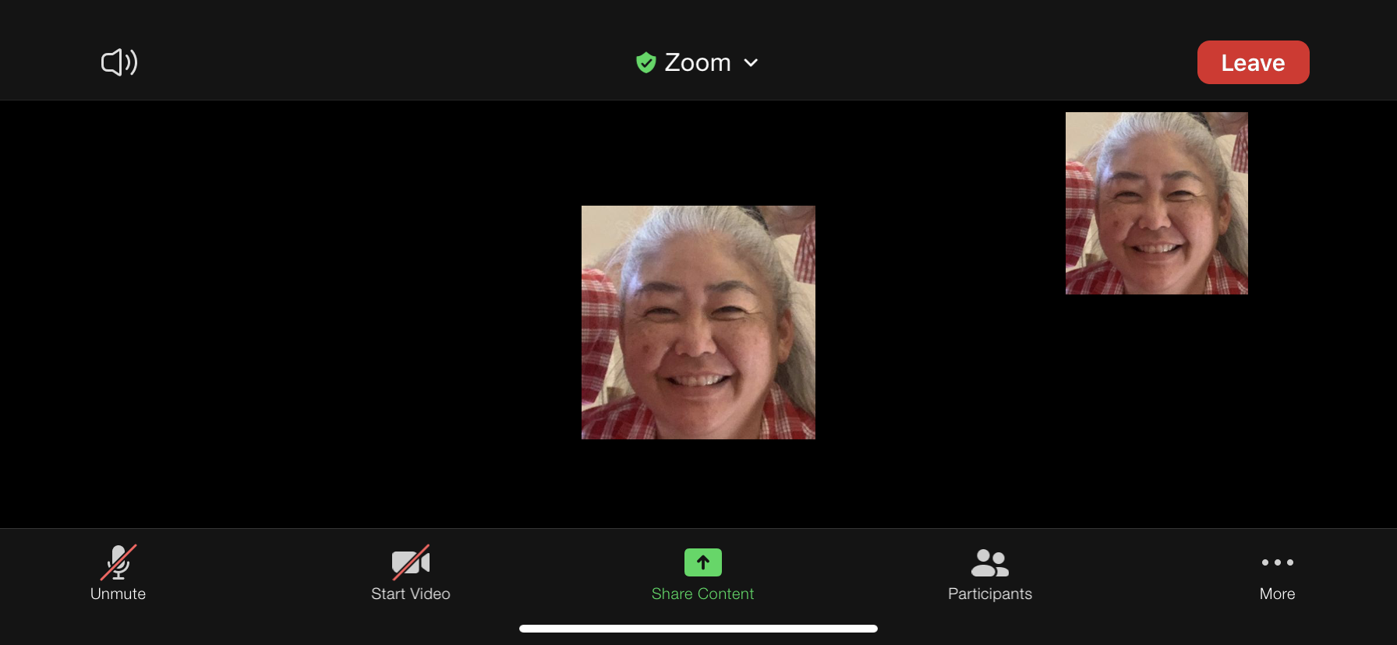
Smart phone (iPhone) view
Microphone muted
Video stopped

Slide 26
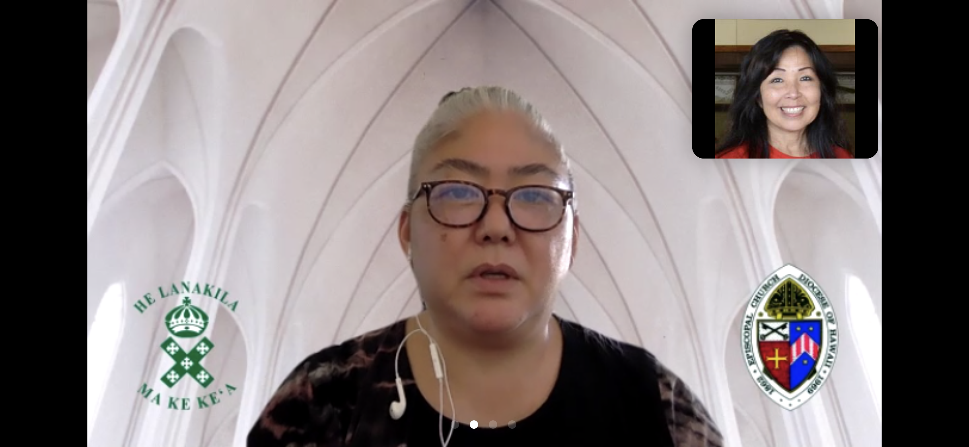
Smart phone (iPhone) SPEAKER view

Slide 27
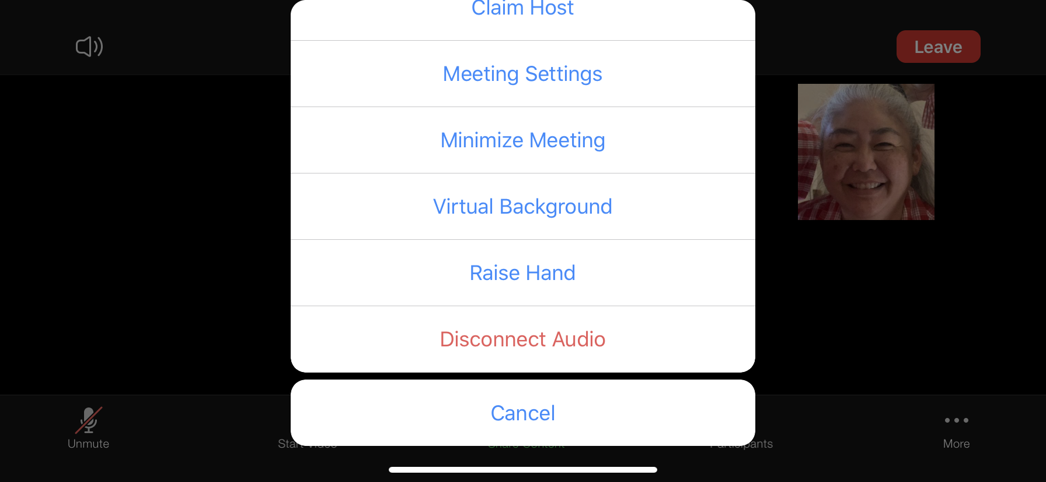
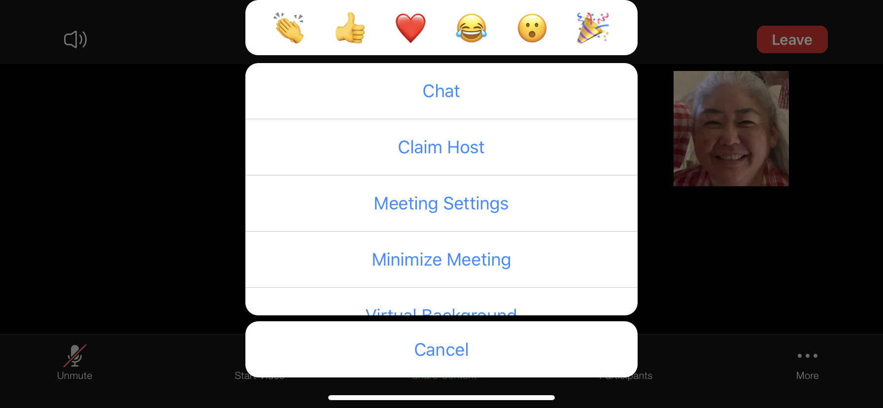
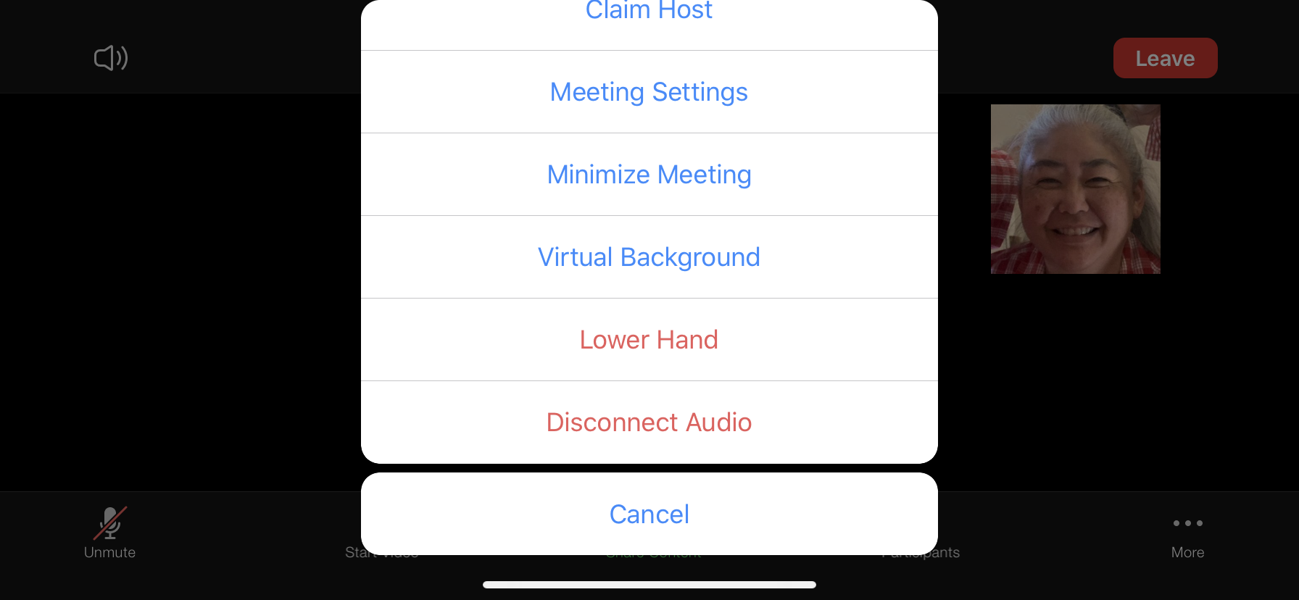
How to raise your virtual hand-smart phone (iPhone) view
1. Tap More
3. Tap on Raise Hand
3
1
2. Scroll up until you see Raise Hand
4. You will see Lower Hand if your hand is raised

Slide 28
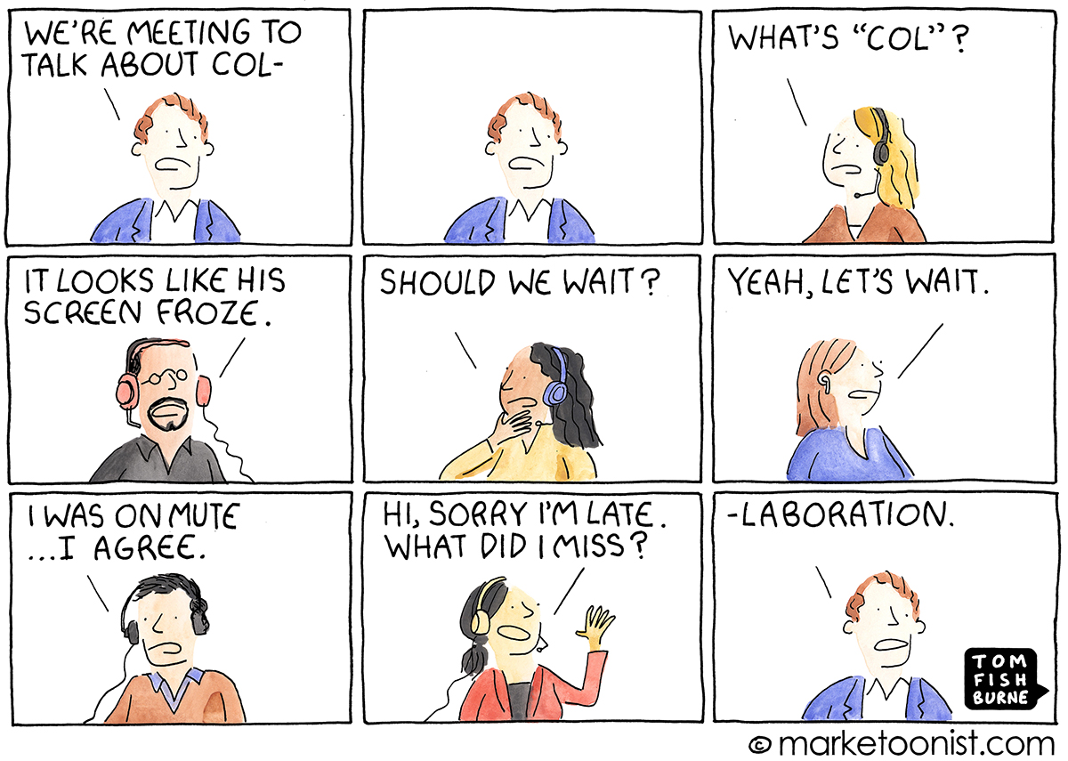

Slide 29
